Slide 1
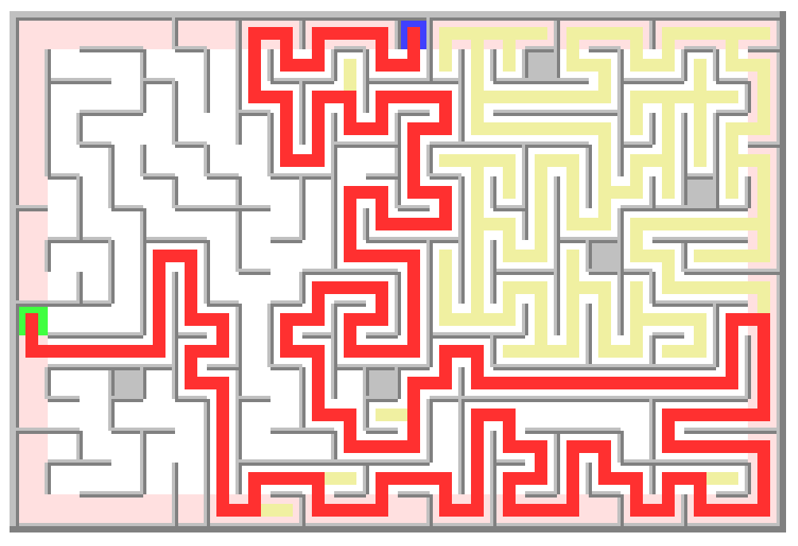
the Maze project
In this project …
…You will write a program accomplishing two major tasks:
  Generate a random two-dimensional maze. The Maze will be created on a grid of Cells of various kinds and will be rendered in a graphical UI (GUI). It will be semantically correct: fills the entire grid, doesn’t isolate unreachable areas, includes one entrance and one exit location, includes some “no-trespass” blocks and guarantees the existence of a path from the entrance to the exit.
  Solve the randomly generated maze. You will design and implement the algorithm that determines automatically the path from the entrance to the exit. The algorithm will render its path exploration in the GUI.
…You will put to use your knowledge of:
Java programming language,
Multi-dimensional arrays,
Random numbers,
Object-Oriented programming,
Complex recursive algorithms,
...
…You will be exposed to and practice with:
Coding larger, complex, multi-class Java projects,
Testing, Tracing and Debugging your code,
Using libraries and working with a Graphical User Interface,
...

Slide 2




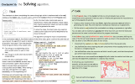

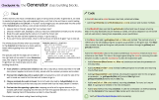




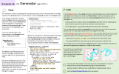









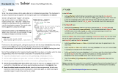


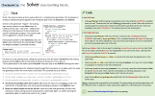




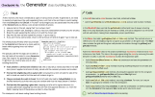
Specification and Checkpoints
the Maze project
The complete project specification can be broken down into the following sections:
When complete, your project includes a full implementation of the following classes:
Program.java:
Main class of the project. Implements the main() method for creating, generating and solving a Maze.
Maze.java:
Implements the Maze as the container for the grid of Cells and for the entrance and exit cells. Implements the maze initialization code.
Cell.java:
Implements the core state and behaviors common to all type of cells.
ShadedCell.java:
Extends Cell with the ability shade the cell in a custom color.
EdgeCell.java and BlockCell.java:
Extend ShadedCell with the specific custom color for the edge or the light-gray shade for the block cell. These cells include the ability to prevent stepping outside the maze’s edges or stepping in or out of a block cell.
EntryCell.java and ExitCell.java:
Extend EdgeCell with the specific custom entry and exit shade colors. Used to identify the entrance into and exit from the maze.
Explorer.java:
Implements the depth-first, recursive exploration algorithm. Provides default implementation for helper methods called internally from within this algorithm.
Generator.java and Solver.java:
Extend Explorer overriding some of its methods in order to generate the maze in a consistent and complete manner, or to solve it by finding a path from the entrance to the exit.
To reach project completeness, the development effort is divided into the following checkpoints:
Object Model | Algorithms | UI design | UML Diagram | API Reference
Checkpoint 1: Maze class. Practicing with MazeCanvas.
Checkpoint 2: Cell classes: Cell, ShadedCell, EdgeCell. Initialize the Maze.
Checkpoint 3: Cell classes: Adding BlockCell, EntryCell, ExitCell to the Maze.
Checkpoint 4: Generator class: Implement the building blocks and the algorithm for generating the maze.
Checkpoint 5: Solver class: Implement the building blocks and the algorithm for solving the maze.
Final 6: Explorer class: Refactor Generator and Solver as extensions of Explorer.

Slide 3
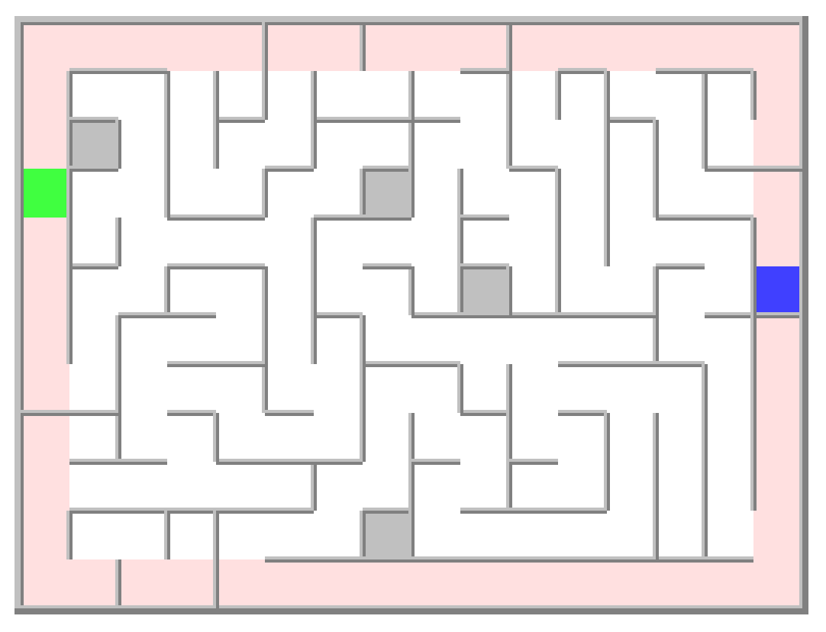


the Maze project
the Object Model
This project is representing a real-life Maze through a collection of classes – known in Object-Oriented Programming as an Object Model. It can be described as follows:
A Maze is a two-dimensional grid of nRows x nCols cells. Each Cell is a square space which may be surrounded by walls on any of its Top, Left, Right or Bottom sides. Some Cells may have a specific shade (background) color. These are ShadedCells. There are several kinds of such cells:
EdgeCell: These are the cells at the edge of the Maze: first and last row and first and last column. Their shade is of a specific edgeColor (your choice) different than the default white. They have walls on their outer sides, but they may or may not have walls on their inner sides. For instance, all EdgeCells on the first row have a wall on their Top side while the ones on last column have a wall on their Right side. The EdgeCell from the bottom right corner of the maze has walls on its Right and Bottom sides.
BlockCell: There are few such cells inside the maze: less than 5% of their total number. These cells have walls on all their sides and have a light gray shade. They represent impassable areas, like a block of concrete covering its entire cell.
EntryCell: This is a special kind of EdgeCell: There is only one such cell, representing the entrance in the maze. It has a shade of a distinct color (your choice), different than the edge shade or the default white.
ExitCell: This is yet another special kind of EdgeCell: There is only one such cell, representing the exit from the maze. Its shade is distinct from all the other shade colors in the maze.
The size of the maze (nRows and nCols) and the various shade colors are your choice. The maze shown on the right is only giving an example of such choices.
Here is an example of a generated Maze of 12 rows and 16 columns. The EdgeCells have a pink shade, the EntryCell is blue and the ExitCell is green.
EdgeCell
is a ShadedCell
is a Cell
pink shade, walls on their outer sides.
Maze
A nRows x nCols two-dimensional grid of Cells of various kinds. Contains a special EntryCell and ExitCell.
0 1 2 3 4 5 6 7 8 9 10 11 12 13 14 15
ExitCell
is an EdgeCell
is a ShadedCell
is a Cell
EdgeCell of green shade, marks the maze exit
1
2
3
4
5
6
7
8
9
10
11
EntryCell
is an EdgeCell
is a ShadedCell
is a Cell
EdgeCell of blue shade, marks the maze entrance
Cell
Interior to the maze, no shade (default – white), may or may not have walls on any of its sides.
BlockCell
is a ShadedCell
is a Cell
Light gray shade, walls on all their sides, impassable.
Ref: classes UML diagram :

Slide 4
the Maze project
exploration Algorithms
An algorithmic description of the dept-first recursive exploration is as follows:
Explorer.run(cell) → boolean // true if done, false otherwise
mark cell as visited
done = false
if cell is the final step then
mark cell as solution
return true
end if
get valid next steps from cell
for each next step and as long as not done do
if neighbor in the next step is not visited then
done = run(neighbor)
end if
end for
if done then
mark cell as solution
end if
return done
end run
There are two tasks this project aims to achieve: generate a random maze and once generated, solve the maze by finding a path from its entrance to the exit. A verbose, high-level description of the logic to approach each of these tasks is as follows:
Generating the maze
Start with a Maze initialized with the grid of cells, each of their specific kind. In their initial state, all cells are walled on all their sides. Starting from the EntryCell tear down the walls separating it from a randomly chosen but valid neighbor. Step to the selected neighbor and repeat this process by exploring its neighbors. If there are no more neighbors to go to, step back to the previous cell for another try. When there are no more next steps possible, the maze is fully generated, is consistent, and with a path guaranteed to exist between any two cells.
Solving the maze
Start with a Maze initialized and already generated as described above. Starting from the EntryCell, choose randomly a valid neighbor to go to. Step to the selected neighbor and repeat this process. If there are no such neighbors, step back to the previous cell and look for another neighbor from that location. At any point the ExitCell is reached, mark the cell as part of the path and return “done” to the previous cell. At any point “done” is returned from a neighbor, do the same: mark that cell as part of the path and return “done”. In the end the chain of marked cells indicates the path from the entrance to the exit of the maze.
Notice the similarities between these algorithms. This is a typical depth-first recursive exploration algorithm. The common behavior can be implemented in an Explorer class while behavior specific to each of the generating and solving algorithms can be captured in the Generator and Solver subclasses.
There are very few parts in this algorithm specific to either the generator or solver: In the generator case, no cell is a final step. Each will have to visit all its neighbors in order to generate the maze fully. In the solver case, if cell is an ExitCell then the terminal step of the path has been discovered so the exploration can be cut short.
While the core part of the algorithm shown above is implemented in the Explorer class, the small differences can be captured in two subclasses, Generator and Solver via overridden methods. More details on how to build these classes are provided further out in this document.
Ref: classes UML diagram :

Slide 5










the Maze project
the User Interface
The startup Java project provided along with this specification contains the MazeCanvas class which can be used for rendering a visual representation of the Maze. The same class provides functionality for visualizing in real time the progress of the exploration algorithms.
Generating the maze
As the generating algorithm progresses, each step forward is rendered as a path connecting the current cell to the next one. The path is rendered in a color of your choice. You can see below some examples of how the UI reflects the progress of the generating algorithm:
Solving the maze
As the solving algorithm progresses, each step forward is shown as a path connecting the current cell to the next one. The path is rendered in a color of your choice. You can see below some examples of how the UI reflects the progress of the solving algorithm:
Step into the cell from its Left side
Solve further by exploring the Top side
Step into the cell from its Bottom side
Generate further by exploring the Right side
drawPath(.. Side.Left, Color.RED)
drawCenter(.. Color.RED)
drawPath(.. Side.Top, Color.RED)
Each time a step forward is no longer possible, and the algorithm backtracks to the previous cell, the path connecting that cell to the current one is retained but rendered in a different color of your choice.
drawPath(..Side.Bottom..)
drawCenter(..)
drawPath(..Side.Right..)
Each time a step forward is no longer possible, and the algorithm backtracks to the previous cell, the path connecting that cell to the current one is erased.
No path via the Bottom side, return to the previous cell.
No path via Top, solve further by exploring the Bottom side
Right side done, generate further by exploring the Top side
All sides done, return to the previous cell
drawPath(..Side.Top, Color.Yellow)
drawPath(..Side.Bottom, Color.Red)
drawPath(..Side.Bottom, Color.Yellow)
drawCenter(..Color.Yellow)
drawPath(..Side.Left, Color.Yellow)
erasePath(..Side.Right..)
drawPath(..Side.Top..)
erasePath(..Side.Top)
eraseCenter(..)
erasePath(..Side.Bottom..)
Ref: MazeCanvas GUI framework:

Slide 6





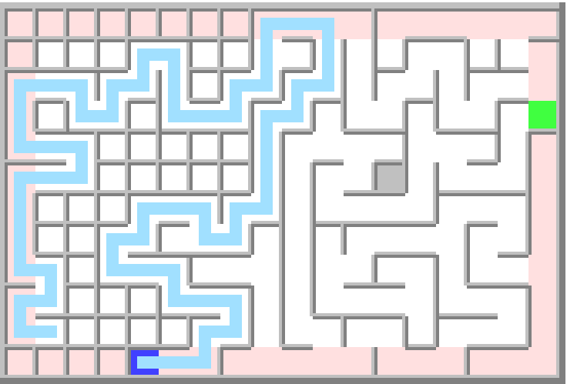
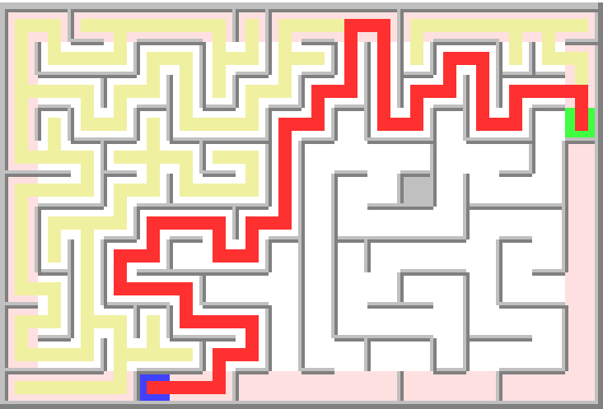
the Maze project
the UML diagram
Explorer
Maze
Cell
_mazeCanvas
_maze
_fwdPathColor, _bktPathColor
_mazeCanvas
_grid[][]
_enterCell, _exitCell
_mazeCanvas
_row, _col
_walls[]
_visited
Models any kind of cell.
Models the engine capable to explore the maze either for generating or for scanning
getOpposite()
shuffle()
onEnterCell()
onGetNextSteps()
onStepForward()
onStepBack()
onExitCell()
run()
getRows(), getCols()
getEnterCell(), getExitCell()
getCell(), getNeighbor()
Initialize()
getRow(), getCol()
getWalls()
getPaths()
getVisited(), setVisited()
removeWall()
Models the entire structure of a Maze as a grid of Cells.
ShadedCell
Models any kind of shaded cell.
_shadeColor
Generator
Solver
onEnterCell()
onGetNextSteps()
onStepForward()
onEnterCell()
onGetNextSteps()
Models any kind of edge (shaded) cell.
EdgeCell
BlockCell
In charge of generating the maze.
In charge of solving a generated maze.
_edges[]
_edgeColor
_blockShadeColor
Models a block (shaded) cell.
getVisited()
getWalls()
getPaths()
EntryCell
ExitCell
_entryShadeColor
_exitShadeColor
Models an Entry (edge, shaded) cell
Models an Exit
(edge, shaded) cell

Slide 7


Checkpoint 1: the Maze class. Practice with MazeCanvas.
Think
 Code
In this checkpoint we will create the main entry point into the project and the first class: Maze. We’ll use this code structure to practice with MazeCanvas functionality by creating the following snake-like pattern. A few things to notice about this pattern:
Download the Maze_Startup.zip file and import it in Eclipse.
Add a Program class to the Maze project src folder, implementing the main() method.
In the Program class define class constants for the number of rows and columns of the maze and the size of a maze cell. Set them to values of your choice.
In the main() method, create an instance of MazeCanvas setting it with the chosen number of rows, columns and cell size from the class constants. You’ll need to import graphics.MazeCanvas in order to have the class available to your code.
On that instance call the open(), pause() and close() methods of the maze canvas.
0 1 2 3 4 5 6 7 8
Most of the cells (the ones in the center area of the maze) look the same:
  They have no Top and no Bottom walls.
  They have a path connecting the Top, Center and Bottom, all of which are colored in RED.
Cells on the first and last row look different, based on their row and on which column they are placed.
0
1
2
3
4
5
6
Run the program! You should see an empty window showing up. Press ‘C’ to allow the program to go past the pause() call. You should see then the window disappearing and the program terminating.
0 1 2 3 4 5 6 7 8
Top row: If the cell’s column is an even number then the cell has no Left and Bottom walls, and the path is connecting the Left, Center and Bottom sides. Otherwise, the cell has no Right wall and the path is connecting the Bottom, Center and Right sides.
Bottom row: If the cell’s column is an even number then the cell has no Top and Right walls and the path is connecting the Top, Center and Right sides. Otherwise the cell has no Left and Top walls and the path is connecting the Left, Center and Top sides.
In addition, all cells on these two rows have a darker red center.
Structuring the code: This is the first checkpoint in a larger project. We need to structure the code such that the project can grow easily. The Maze class will encapsulate the functionality for this and future checkpoints. For now, this class implements the genSnake() method only. The Program class will contain the main() method can then be as simple as follows:
Create and open a MazeCanvas instance.
Create a Maze instance passing to it the MazeCanvas object as the rendering engine.
Call the Maze’s genSnake() method from main(). All rendering happens inside that method.
Add a Maze class to the project.
Add a Maze(MazeCanvas mazeCanvas) constructor to the class. Save its parameter in a class data field.
Add a method genSnake() to the Maze class. In it, implement the algorithm described on the left for generating the snake. The method takes no parameters since it already has all the information needed to render the snake, through the MazeClass data field. It will use it to determine the number or rows and columns of the maze and to draw the cells, erase their walls and draw the paths as needed.
In the main() method of the Program class, create an instance of the Maze class and call its genSnake() method. Make this call right after the maze canvas was opened and before the call into the pause() method.
Run the program! If you implemented everything correctly you should see the maze canvas filled in with the snake kind of shape as shown on the left.
Verify the MazeCheckpoint1.java tests are passing.
Ref: MazeCanvas GUI framework:

Slide 8


Checkpoint 2a: the Cell, ShadedCell, EdgeCell classes.
Think
 Code
So far, we have an instance of the Maze class, implementing the genSnake() method.
In this checkpoint we create the smallest building blocks making up the maze, starting with the Cell class. Each square area in the maze is modeled by a Cell object.
Add a Cell class to the project, containing several data fields: the row and column (int), a mazeCanvas reference and a listOfWalls sides surrounding the cell. Add a Cell(MazeCanvas mazeCanvas, int row, int col) constructor to the class. Inside, save the parameter values in the class data fields. Initialize the listOfWalls to all sides {Top, Left, Right, Bottom}. Use the mazeCanvas to draw the cell at the row and col location. Add the getRow(), getCol() and getWalls() accessors for the data fields. Note: the getWalls() needs to return a copy of the internal listOfWalls to prevent the callers of this method from changing the internal state of the cell. Add the removeWall(Side side) method. It uses the mazeCanvas to erase the wall on that side of the cell and keeps track of this change of state by removing the given side from the internal listOfWalls.
Add a ShadedCell class as an extension of Cell and containing a shadeColor class field storing the shade of the cell. Add a ShadedCell(MazeCanvas mazeCanvas, int row, int col, Color shadeColor) constructor to the class. After calling its super() with the parameters it needs, use the mazeCanvas and the shadeColor to draw the shade of this cell. Save the shadeColor parameter in the corresponding class field.
Add an EdgeCell class as an extension of ShadedCell. It contains a listOfEdges as a data field and an edgeColor constant set to a color of your choice. Add an EdgeCell(MazeCanvas mazeCanvas, int row, int col) constructor to the class. It calls its super() with the same parameters, plus the chosen edgeColor. In addition, it uses the mazeCanvas, row and col to determine the maze edges for this cell and add them to the listOfEdges data field. Override the getWalls() method from the Cell class and have it remove the maze edges (available in the listOfEdges) from the list of walls it returns.
Cell
A Cell “knows” its row and column and has a reference to a mazeCanvas which it can use for drawing itself at the given location. It also contains a list of wall sides, which by default are all of them: Top, Left, Right, Bottom. All this information represents the cell’s state (class fields). The cell’s behaviors (methods) allow accessing its internal data as well as removing the wall on a given side. This latter capability is going to be needed a little later, when we generate the maze.
_mazeCanvas
_row, _col
_walls[]
getRow(), getCol()
getWalls()
removeWall()
ShadedCell
A ShadedCell is a very simple extension of a generic Cell. It only contains a specific color which is used to render its shade as soon as the cell has been drawn on the canvas.
_shadeColor
EdgeCell
The EdgeCell is an extension of a ShadedCell. It contains a color of choice, used for shading cells bordering the maze. It also keeps track of the edges of the cells bordering the maze such that they can be removed from the list of walls returned by the cell’s getWalls() accessor. This will be needed later, when implementing the exploration algorithms.
_edges[]
_edgeColor
getWalls()
EdgeCell(mazeCanvas, row, col)
..
if first row then
add Side.Top to listOfEdges
else if last row then
add Side.Bottom to listOfEdges
endIf
if first col then
add Side.Left to listOfEdges
else if last col then
add Side.Right to listOfEdges
endIf
○
Determining the edge sides of this cell is as simple as testing the row and column for 0 and the size of the grid (given by the mazeCanvas). These edges need to be removed from the list of walls of this cell, as shown in the pseudo-code below:
getWalls() → walls
walls = super.getWalls()
for each edge in listOfEdges do
remove edge from walls
endFor
return walls
○
Verify all MazeCheckpoint2a.java tests are passing.
Ref: classes UML diagram :
Notes:
Cell class: Hint for cloning an ArrayList:
ArrayList<Side> clone = new ArrayList<Side>();
clone.addAll(orig);
ShadedCell class: The shadeColor is truly not necessary!

Slide 9
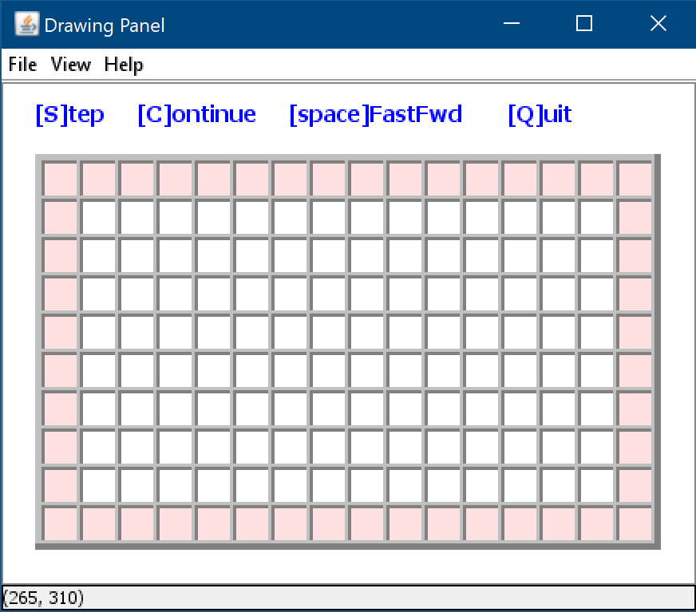
Checkpoint 2b: initialize the Maze.
Think
 Code
Having the Cell and EdgeCell classes, the Maze class now needs to define a grid of cells as a class data field. There are two steps in this process:
In the Maze class: Add a new gridOfCells data field of type Cell[][]. In the Maze(MazeCanvas mazeCanvas) constructor create a two-dimensional array of Cells sized to the number of rows and columns of the mazeCanvas parameter. Save the array in the gridOfCells class data field. Add a new method initialize(). It takes no parameters and returns no value. In it, implement the algorithm described on the left to fill in the gridOfCells with the correct Cell instances. Add a new method getCell(int row, int col). It takes a row and column location as parameter and returns the Cell instance at that location. This method is going to be needed later.
In the Program class, in the main() method you should already have a Maze instance created and used for calling into its genSnake() method. This was done as part of Checkpoint 1. Replace the call to genSnake() with a call to its new initialize() method.
Maze
Cell
Creating the grid means creating a new two-dimensional array of type Cell[][] and save it in the class data field. Its number of rows and columns are given by the size of the MazeCanvas instance, which is already a data field in the Maze class.
Creating the grid can be implemented inside the Maze class constructor.
_mazeCanvas
_grid[][]
getRows(), getCols()
getCell(), initialize()
ShadedCell
EdgeCell
Initializing the grid means creating a new instance of type Cell for each of the locations in the grid. If the location is on the edge, then the actual instance is of type EdgeCell otherwise is a regular Cell. The polymorphic capability of Java allows for both to be “seen” as Cell objects since EdgeCell is-a ShadedCell which is-a Cell.
This can be implemented as part of a new initialize() method of the Maze class. The pseudo-code for this method looks like below:
Maze.initialize()
for each [row, col] in the grid do
if [row, col] is on edge then
grid[row,col] ← new EdgeCell
else
grid[row,col] ← new Cell
endIf
endFor
○
Notice that Cell and EdgeCell instances are drawing themselves on the maze canvas when they are created. This means that once the maze initialization is complete, the canvas will automatically be filled with a drawing like below:
Run and verify the program. You should see a drawing like the one on the left.
Verify all MazeCheckpoint2b.java tests are passing.
Notice that unlike the genSnake() method from before, now the Maze class is no longer in charge of doing any drawing. It is delegating this task to the various Cell objects which will draw themselves based on their specific type. From the Maze point of view, they are all abstracted out as Cells.
Ref: classes UML diagram :

Slide 10

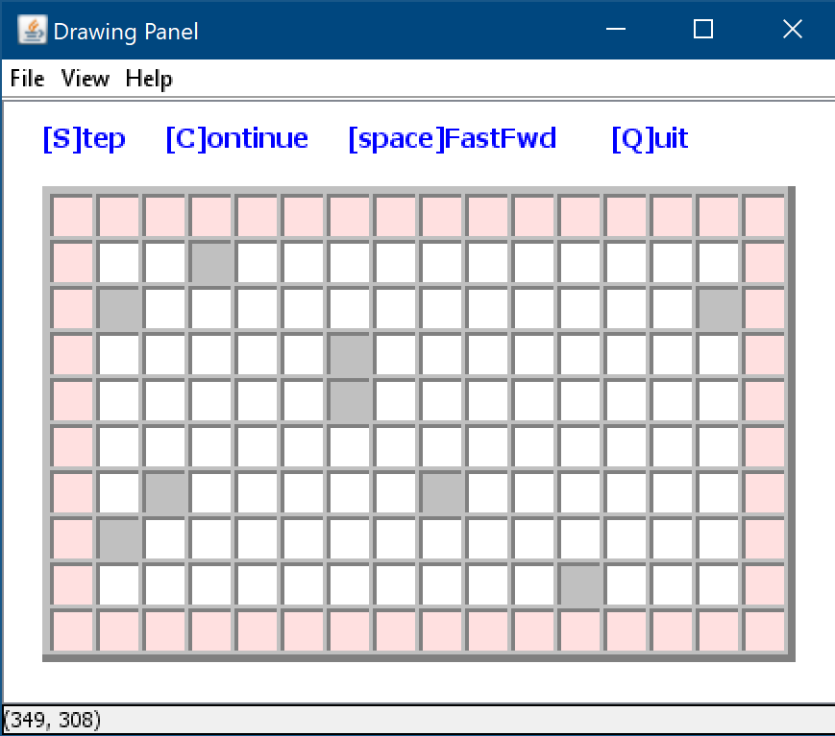

Checkpoint 3a: the BlockCell class.
Think
 Code
The maze includes another special kind of cells: the block cell. These are a small subset (<5%) of its interior cells. They represent areas in the maze which cannot be passed through: they have walls on all sides and are drawn with a light-gray shade. As such, a block cell is nothing more than as a specialized version of a shaded cell.
Add a BlockCell class to the project as an extension of the ShadedCell and containing a blockShadeColor class constant set to LIGHT_GRAY. Add a BlockCell(MazeCanvas mazeCanvas, int row, int col) constructor to the class. Inside, call the super() constructor providing to it the same parameters plus the blockShadeColor value.
In the Maze class, modify the initialize() method by implementing the logic in the pseudo code described on this page.
Extra challenges: How would you modify the code to guarantee that exactly 5% of the interior cells are BlockCells? How would you guarantee that no two BlockCells are adjacent to each other? Hint: A more sophisticated way to select the BlockCells is to start by constructing a separate list of all the interior cell locations, then randomly eliminate locations from that list until it contains no more than the desired number. The remaining locations would then be replaced in the grid by BlockCell objects.
In OOP terminology, a block cell is modeled as the BlockCell class, an extension of the ShadedCell class.
A ShadedClass is drawn in its class constructor. As such, drawing a BlockCell at a given row and column can be done by calling its super class constructor with a light-gray shade color added to its list of parameters.
The code drawing the maze is in the Maze class initialize() method which now needs to be updated.
Cell
ShadedCell
EdgeCell
BlockCell
_blockShadeColor
Run and verify the program.
The simplest way to incorporate BlockCells in it is to modify that method as follows:
When a random value is <= 0.05 and less than 5% of the interior Cells are already BlockCells, then add to the grid a new BlockCell instead of a regular Cell and update the counter tracking their number. This is shown in the pseudo code below:
Verify all MazeCheckpoint3a.java tests are passing.
Maze.initialize()
count ← 5% of all interior cells
for each [row, col] in the grid do
if [row, col] is on edge then
grid[row,col] ← new EdgeCell
else if rnd < 0.05 and count > 0 then
grid[row,col] ← new BlockCell
count ← count - 1
else
grid[row, col] ← new Cell
endIf
endFor
○
When all is done, running the program should draw a maze like below:
Ref: classes UML diagram :
Notes:
Tests for Checkpoin3a are passing too early: test for initialize passes with 0 BlockCells. Can mock Random?

Slide 11
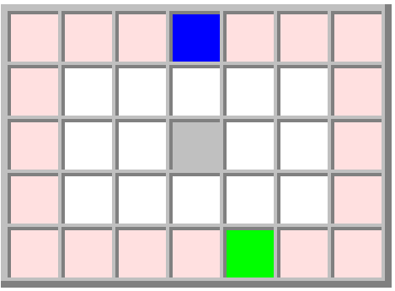
Checkpoint 3b: Adding the EntryCell and ExitCell to the Maze.
Think
 Code
Cell
There are two more kinds of cells that need to be implemented: The cell modeling the entrance and exit from the maze. These are the EntryCell and the ExitCell. There’s only one instance of each, located on the edge of the maze, so these classes are natural extensions of the EdgeCell. Each has a different shade, which is also different than any other
shade used already (edge or block).
Add an EntryCell class and an ExitCell class to the project, as an extension of the EdgeCell, each containing an entryShadeColor and exitShadeColor class constants, set to a color of your choice, different than all the other. Add class constructors EntryCell(MazeCanvas mazeCanvas, int row, int col) and EntryCell(MazeCanvas mazeCanvas, int row, int col). After the call to super() use the mazeCanvas to change the shade of the cells to their respective colors.
In the Maze class, modify the initialize() method by implementing the logic in the pseudo code described on this page. Run the program. At this point the maze should show all cells: Edge, Block, Entry and Exit and should be ready for designing the generating and solving algorithms.
Add two accessor methods to the Maze class, returning the unique EntryCell and ExitCell instances: getEntryCell() and getExitCell(). Those are going to be needed later. Verify all MazeCheckpoint3b.java tests are passing.
Extra challenge: How would you modify the code to guarantee that the two numbers iEntry and iExit are not only distinct, but also farther away from each other? Hint: Generate a random iEntry number. To have iExit at a ¼ perimeter distance from iEntry, its range will be [iEntry + ¼ * nPerim, iEntry + ¾ * nPerim). Apply a modulo nPerim to its value to guarantee it will not get out of bounds.
ShadedCell
EdgeCell
BlockCell
Like in the previous case, drawing an EntryCell or an ExitCell means drawing the underlining EdgeCell then customizing shade color. This is all done in the class constructors.
EntryCell
ExitCell
_entryShadeColor
_exitShadeColor
With the EntryCell and ExitCell class implemented, we need to modify the initialize() method of Maze in order to place one instance of each along the edge of the maze.
One way of doing it is as follows:
Calculate the number of cells on the perimeter of the maze: nPerimeter.
Generate two distinct random numbers, iEntry and iExit, in the range [0 .. nPerimeter).
In the loop generating the cells, keep a counter for the cells on the edge. If the counter matches iEntry or iExit, generate an EntryCell or ExitCell instead.
To the right you can see the
pseudo-code implementing this logic:
Maze.initialize()
nPerim ← 2 * rows + 2 * cols – 4
iEntry and iExit ← random nums in [0 .. nPerim)
edgeCount ← 0
for each [row, col] in the grid do
if [row, col] is on edge then
if edgeCount is iEntry then
grid[row,col] ← new EntryCell
else if edgeCount is iExit then
grid[row,col] ← new ExitCell
else
grid[row, col] ← new EdgeCell
endIf
increment edgeCount
else ...
...
○
Example: In the maze below, the perimeter count is 20, the iEntry is 3 and iExit is 17.
0 1 2 3 4 5 6
7 8
9 10
11 12
13 14 15 16 17 18 19
Ref: classes UML diagram :
Notes:
Hint:
// index of the entry cell along the edge is a random number in the range [0..nPerim-1]
int iEntry = (int)(Math.random() * nPerim);
// index of the exit cell is shifted away from the entry cell with a random number
// in the range [1..nPerim-1] modulo nPerim. The modulo is to avoid an IndexOutOfBounds.
int iExit = (iEntry + 1 + (int)(Math.random() * (nPerim - 1))) % nPerim;
// count of cells on the edge that were already generated.

Slide 12
Checkpoint 4a: the Generator class building blocks.
Think
 Code
At this moment, the maze is initialized as a grid of various kinds of cells. To generate it, we need to randomly break down the walls separating them, such that in the end there is a path leading from the EntryCell to the ExitCell. In “human” words imagine you are parachuted into the center of the EntryCell and you follow a very simple checklist of actions:
In the Cell class add a visited boolean class field, initialized to false. Add the getVisited() and setVisited(boolean visited) accessor and mutator methods.
In the BlockCell class override the getVisited() method and have it always returning true. In this way BlockCells are pre-marked as visited, will not be stepped in so will be left with all walls intact, making them impassable, as per specification.
In the Maze class add a getNeighbor(Cell cell, Side side) method. The method returns a reference to the cell neighboring the one given as parameter on the given side. The Maze class contains the grid and the given cell provides its location through its getRow() and getCol() methods.
Add a new Generator class to the project containing a mazeCanvas instance and a maze instance as class fields. This class is the engine generating the maze by removing the walls between its cells. It uses the mazeCanvas to draw the exploration path. Add a Generator(MazeCanvas mc, Maze m) constructor and save the parameters in the class fields. Add a shuffle(List<Side> sides) method shuffling the given list of sides and returning the shuffled result. Add a getOpposite(Side side) method, returning the opposite side for the one given as parameter. I.e. getOpposite(Side.Left) returns Side.Right and getOpposite(Side.Bottom) returns Side.Top. Add a run(Cell cell, Side side) method, returning a boolean. For now, let it return false. It is going to be needed in the next checkpoint. Add a run() method returning a boolean. It calls the overloaded run method passing to it the EntryCell of the maze and Side.Center and it returns its result.
Leave a mark in the cell, saying that “you’ve been here”.
Choose a random wall, leading to a cell you have not visited before (initially true for all cells).
Break the walls separating the cell you’re in and the chosen cell.
Step into the new cell and repeat the process → go to step (1).
If you can’t find a wall to break, return to the previous cell and do it again→ go to step (2).
The whole process finishes when you are back to the EntryCell and there are no more walls to break without getting into a cell visited already.
The pseudo code for this logic can be seen on the right and will be coded in a new Generator class, the “engine” for generating the maze.
To get there we need to take care of a few building blocks first:
Generate.run(cell, fromSide)
mark cell as visited
remove cell’s wall fromSide
get and shuffle the cell’s list of walls
foreach side in the list of walls do
get neighbor from that side
if neighbor is not visited then
remove cell’s wall on that side
Generate.run(neighbor, opposite(side))
endIf
endForeach
○
Track whether a cell has been visited or not: this is naturally a visited class field in the Cell class (since it applies to all kinds of cells), paired with the necessary accessor and mutator.
Find out the neighboring cell on a given side: knowing the current cell and the side of the wall to break we need to find the next cell instance to go to.
Choose randomly the walls to break: the list of walls returned by Cell.getWalls() can be shuffled randomly such that next steps are random and thus the maze pattern is random.
Find out the side opposing a given side: stepping out of a cell in a given direction (i.e. towards Left) means stepping into the next cell from the opposite direction (i.e. from the Right). Keeping track of these allows us later to draw the path.
This checkpoint is all about coding these building blocks.
Verify all MazeCheckpoint4a.java tests are passing.
Notes:
run(Cell cell, Side side) can be made private!

Slide 13
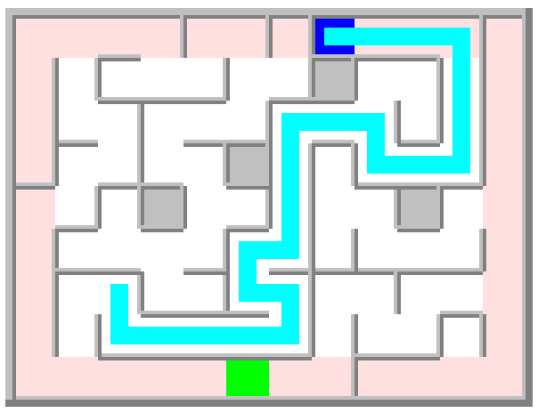
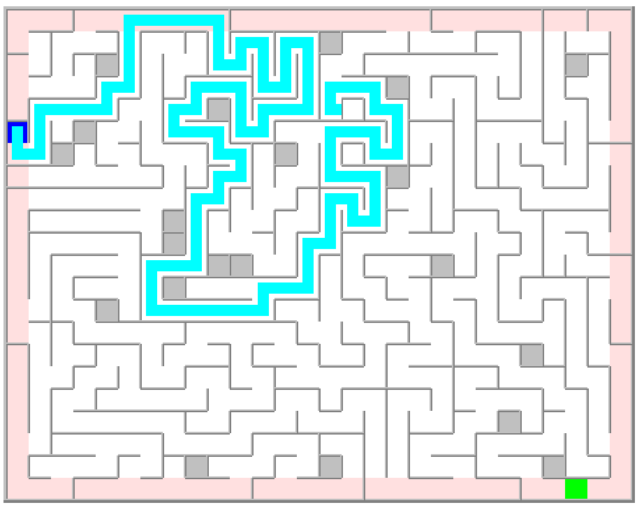
Checkpoint 4b: the Generator algorithm.
Think
 Code
This checkpoint is about completing the maze generating logic which is implemented in the run() method of the Generator class. Its client code is wired in the main() method of the Program class:
In the Program class, in the main() method you should already have a maze instance of class Maze and a mazeCanvas instance of MazeCanvas. They were created as part of Checkpoint 1. You should also have a call to maze.initialize() method, done as part of Checkpoint 2b.c Create a generator instance of the class Generator, right after the line initializing the maze. Pass the maze and mazeCanvas instances as its parameters. Call the generator’s run() method right after the generator initialization. You can add a call to mazeCanvas.pause() after these two lines such that the execution pauses once the maze is generated, before the program terminates.
In the Generator class, add a generatePathColor class constant defining the color of the exploration path shown during maze generation. Set it to a color of your choice. Implement the run(Cell cell, Side fromSide) method from the pseudo code. Use generatePathColor when drawing the path components inside the cell. You can add one or more mazeCanvas.step(millis) calls inside the method such that you can trace the algorithm progression in a step-by-step manner.
To do its job, the generator instance needs the Maze instance holding all the data of the maze, and the MazeCanvas instance needed for rendering the progress of the generating logic. Those are provided in the Generator class constructor.
Two more methods need to be implemented in the Generator class: run() and run(cell, fromSide).
Program.main()
create new mazeCanvas instance
create new maze instance ← mazeCanvas
open mazeCanvas
initialize maze
create new generator ← mazeCanvas, maze
generator.run()
close mazeCanvas
○
run() is the starting point, calling the run(cell, fromSide) with the entryCell of the maze, available through maze’s getEntryCell() method, and Side.Center as the first direction of movement. This is akin to:
“you just got parachuted in middle of the EntryCell”.
Generate.run()
Generate.run(
maze.getEntryCell(),
Side.Center)
○
Generate.run(cell, fromSide)
mark cell as visited
draw in cell path fromSide and Side.Center
remove cell’s wall fromSide
get and shuffle the cell’s list of walls
foreach side in the list of walls do
get neighbor from that side
if neighbor is not visited then
draw in cell path to side
remove cell’s wall on that side
Generate.run(neighbor, opposite(side))
erase from cell path from side
endIf
endForeach
erase Side.Center and path fromSide
return false
○
If everything was implemented correctly, at this point you are able to generate mazes and trace the algorithm progression like in these images:
The run(cell, fromSide) pseudo code, shown to the right, implements the recursive algorithm for generating the maze.
Notice the highlighted code lines. They are using the mazeCanvas class field in order to draw the path into the cell, showing the steps to and back from each neighboring cells. When the cell exploration is complete, the path going through it is erased.
Run and verify the program. Trace the execution by pressing the ‘S’ key and observe the recursive and backtracking steps of the exploration.
Generate mazes of different sizes using different shades and path colors.
Verify all MazeCheckpoint4b.java tests are passing.
Notes:
4b tests do not pay attention to cell center and path.
Styling: constants should be ALL_CAPS!
Can incorporate head

Slide 14
Checkpoint 5a: the Solver class building blocks.
Think
 Code
So far, the maze contains an Entry and an Exit cell, is initialized and generated. This checkpoint is all about implementing the algorithm for finding the path from the EntryCell to the ExitCell.
In the Cell class: Add a getPaths() method taking no parameters and returning the listOfPaths available from this cell. These are all the cell’s Sides not bordered by a wall. Start with a new list containing all four sides, then remove from it all the wall sides of the cell. These are available in the cell’s listOfWalls. The method returns the resulting list.
In the EdgeCell class: Overload the getPaths() method such that it removes the listOfEdges from the listOfPath returned by super.getPaths(). This is needed because an EdgeCell does not have walls on the sides edging the maze, but those openings are not to be considered part of the possible paths out of the cell.
Add a new Solver class to the project containing a mazeCanvas and a maze as class fields. This is the engine solving the maze by stepping from one cell to the other, starting from the EntryCell, until the ExitCell is reached.. Add a Solver(MazeCanvas mc, Maze m) constructor and save the parameters in the class fields. Add a run(Cell cell, Side side) method, returning a boolean. For now, let it return false. It is going to be needed in the next checkpoint. Add a run() method returning a boolean. In it, in a loop, reset the visited state to false for all the maze‘s cells. Then, call the overloaded run method passing to it the EntryCell of the maze and Side.Center and it returns its result. Copy the shuffle() and getOpposite() methods from the Generator class into the Solver class. Notice: copying code is generally to be avoided. The generating and solving algorithms will be refactored later in a generic maze exploration algorithm, eliminating this redundancy.
Similar to the generator “engine”, the solving logic can be coded in a new Solver class. An instance of this class - the solver - needs only a reference to the maze and to the mazeCanvas used for drawing the progress. The pseudo code for this algorithm is shown to the right:
Following the pattern of the Generator class, the Solver class implements the solving logic through the run() and run(cell, fromSide) methods.
Solver.run(cell, fromSide)
mark cell as visited
if cell is the Exit then
return true
endIf
get and shuffle the cell’s list of paths
foreach side in list of paths do
get neighbor from that side
if neighbor is not visited then
Solve.run(neighbor, opposite(side))
if maze is solved then
return true
endIf
endIf
endForeach
return false
○
Solver.run()
mark all cells as not visited
Solve.run(maze.getEntryCell(), Side.Center)
○
The first one is the starting point, calling the second one with the maze’s EntryCell as the starting location and the Side.Center as the initial direction of movement. This is akin to:
“You’re parachuted in the center of the EntryCell. Find your way to the ExitCell starting from here”.
Most of the building blocks for implementing this algorithm have been put in place when the maze was generated, only a few more need to be coded. The complete list is as follows:
Track the cell visited state: available via Cell’s getVisited(), setVisited() methods.
Get the cell’s neighbor on a given side: available via Maze’s getNeighbor() method.
Get the opposite of a given side: available in Generator’s getOpposite() method.
Get the list of possible paths from a given cell: these are sides of a cell without a wall. This method fits in the Cell class, with some special handling (overload) in the EdgeCell. class.
Reset the visited marker across for all cells: when the maze was generated, all cells were marked as visited. Solving involves tracking their visited state again, so, before starting the exploration again it needs to be reset to not_visited.
Verify all MazeCheckpoint5a.java tests are passing.
Notes:
Some 5a tests are passing as soon as checkpoint 4 is complete!
getPaths() can be explained better (subtle faulty code: iterate through a new listOfPath and remove from it the existent walls: you can’t modify a list while in an iterator on it)

Slide 15
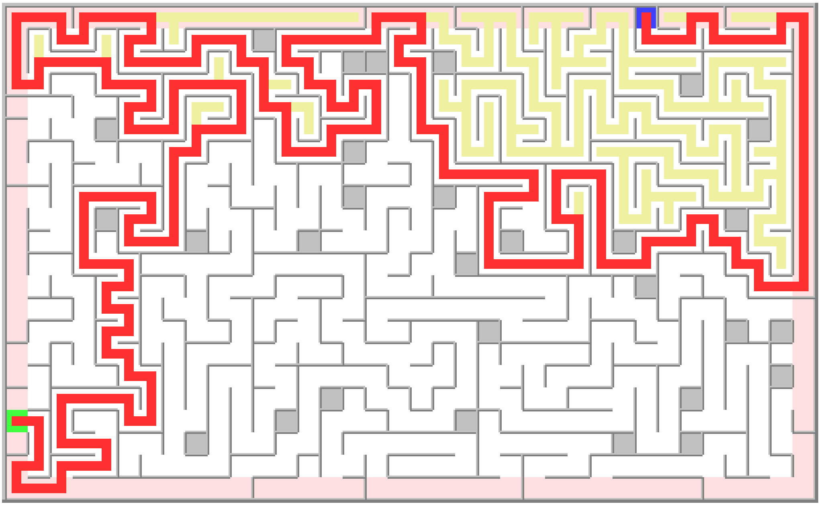
Checkpoint 5b: the Solving algorithm.
Think
 Code
This checkpoint is about completing the maze solving logic which is implemented in the run() method of the Solver class. Its client code is wired in the main() method of the Program class.
In the Program class, in the main() method you should already have a maze, mazeCanvas and a generator instances used to initialize and generate the maze (done as part of Checkpoints 2b and 4b). Create a solver instance of the class Solver, right after generator.run() call which is generating the maze. Pass the maze and mazeCanvas instances as its parameters. Call the solver’s run() method (the overloaded one taking no parameters) right after. You can add a call to mazeCanvas.pause() after these two lines such that the execution pauses once the maze is solved and before the program terminates.
In the Solver class, add a fwdPathColor and a bktPathColor class constants defining the color of the forward and backgrack exploration paths as shown in the pseudocode on the left. Set them to two different colors of your choice. Implement the run(Cell cell, Side fromSide) method from the pseudo code. Use fwdPathColor when drawing the path components when stepping inside a cell, or forward, to a neighboring cell. Use bktPathColor when the recursive call didn’t result in path, such that the explored part of the maze remains visible. You can add one or more mazeCanvas.step(millis) calls inside the method such that you can trace the algorithm progression in a step-by-step manner.
Program.main()
create new mazeCanvas instance
create new maze instance ← mazeCanvas
open mazeCanvas
initialize maze
create new generator ← mazeCanvas, maze
generator.run()
create new solver ← mazeCanvas, maze
solver.run()
close mazeCanvas
○
So far, the client code creates and opens a mazeCanvas, creates and initializes a maze object, then creates a generator object and calls its run() method to generate the maze.
To solve the maze, the client code only needs to create a solver object and call its run() method as shown to the left.
The algorithm solving the maze is implemented
in the overloaded run(cell, fromSide) method of the Solver class: given a cell and the side that cell
was entered, the algorithm needs to identify all possible “next steps” from that location. Those are governed by a few simple rules:
Can only go to a neighboring cell to which a path exists (no wall on that side).
Can only go to a cell which has not been visited before.
A valid next step is attempted. If that doesn’t lead to the ExitCell, another step is tried until either a path is found (return true) or all next steps were explored unsuccessfully (return false). When taking a next step, the algorithm runs again, recursively, on the neighboring cell.
Entering a cell and exploring a next step, is drawn as a “forward path”, in some color. Coming back after exploring a next step is a
Solver.run(cell, fromSide)
mark cell as visited
draw fwdPath fromSide and Side.Center
if cell is the exit then
return true
endIf
get and shuffle the cell’s list of paths
foreach side in list of paths do
get neighbor from that side
if neighbor is not visited then
draw fwdPath to side
Solve.run(neighbor, opposite(side))
if maze is solved then
return true
endIf
draw bktPath from side
endIf
endForeach
draw bktPath for Side.Center and fromSide
return false
○
If everything was implemented correctly, at this point you are able to solve mazes and trace the exploration logic like in this image:
Run and verify the program.
“backtrack path”, drawn in a different color, unless that path led to the ExitCell.
Verify all MazeCheckpoint5b.java tests are passing.

Slide 16
Final 6a: refactor Generator and Solver. The Explorer class.
A callback method is just an informal name given to a normal method which is called from other parts of the code when certain well-defined event or conditions occur.
Think
 Code
For this checkpoint, review your implementations for generating and solving the maze. Notice how similar they are. In both cases, there are different actions taken when a cell is entered, when determining the next possible steps, when stepping forward, stepping back and when exiting. Other than that, the algorithms gluing these actions are identical.
Let’s refactor the code by creating and calling these methods in each of the Generator and Solver classes.
In each of the Generator and Solver class add the following callback protected methods: onEnterCell(Cell cell, Side side) - takes as parameters the cell being entered and the side where it is entered from. onGetNextSteps(Cell cell) – takes as parameter the cell being inspected for the next maze generation step. Method returns the resulting list of walls in the Generator’s case, and the list of paths in the Solver’s case. onStepForward(Cell cell, Side side) – takes as parameters the cell and its side where the maze generating algorithm should step further. onStepBack(boolean done, Cell cell, Side side) : takes as parameter a cell and the side that was just explored. It also takes the boolean done, telling if the exploration is complete or not (in Generator’s case always false; in Solver’s case, true if a path to the exit was found, and false otherwise). onExitCell(boolean done, Cell cell, Side side) : takes same parameters a cell and the side on which the cell is about to be exited. It also takes the Boolean done, telling if the exploration is complete. In each of these methods, copy the code parts from the corresponding run(Cell cell, Side side) method of their classes, as described on the left side of this slide.
In the Solver class modify the run(Cell cell, Side side) method by replacing all code parts copied into the new methods, with the corresponding method calls and implementing the pseudo code on this slide.
In the Generator class modify both the run() and the run(Cell cell, Side side) method by copying over the same methods from the Solver class.
At this point, the project is functionally unchanged, but the Generator and Solver classes contain a fair amount of identical code. This is going to be factored out next, into a new Explorer class.
Generator/Solver.run(cell, fromSide)
mark cell as visited
done ← onEnterCell(cell, fromSide)
list of paths ← onGetNextSteps(cell)
foreach side in list of paths do
if not done then
get neighbor from that side
if neighbor is not visited then
onStepForward(cell, side)
done ← Explorer.run(neighbor, opposite(side))
onStepBack(done, cell, side)
endIf
endIf
endForeach
onExitCell(done, cell, fromSide);
return done
○
Generator
Solver
Draws the cell’s path fromSide. Returns false since there is no “exit” during maze generating process (all maze needs exploring)
Returns the cell’s list of walls, shuffled.
Draws the cell’s path side leading out and removes the wall separating it from next cell.
Erases the path side coming back into the cell.
Erases the path fromSide, leaving the cell.
Draw the cell’s path fromSide. Returns true if the cell is the exit from the maze.
Returns the cell’s list of paths, shuffled.
Draw the cell’s path side leading out to the next cell that has not been explored yet.
If not done, draws the path side coming back into the cell, in a distinct color.
If not done, draws the path leaving the cell, in a distinct color.
Verify all MazeCheckpoint6a.java tests are passing.

Slide 17
Final 6b: refactor Generator and Solver. The Explorer class.
Think
 Code
The Generator and Solver classes are now restructured in a way that highlights their common state (fields) and behavior (methods):
Add an Explorer class to the project, having maze, mazeCanvas, fwdPathColor and bktPathColor as protected class fields. In it: Add a constructor Explorer(MazeCanvas mc, Maze m, Color fwdColor, Color bktColor) initializing the class fields from the given parameters. Copy the shuffle() and getOpposite() methods from either the Generator or Solver and change their accessibility from private to protected. Copy both the run() and run(Cell cell, Side fromSide) methods from either the Generator or Solver since their implementation is identical in both.
Add the callback methods to the Explorer class as protected methods: onEnterCell(Cell cell, Side side) – draws the side path and center of the cell. In fwdPathColor (if color is not null). Returns false. onGetNextSteps(Cell cell) – returns a new and empty List<Side>. onStepForward(Cell cell, Side side) – draws the side path of the cell, in fwdPathColor. onStepBack(boolean done, Cell cell, Side side) – if not done, either draws or erases the side path of the cell, depending on whether bktPathColor is set to a non-null value. onExitCell(boolean done, Cell cell, Side side) – if not done, either draws or erases the side path and center of the cell, depending on whether bktPathColor is not null.
Make the Generator and Solver classes extensions of the Explorer class, delete their class fields (now encapsulated in their super class) and modify their methods as follows: Delete shuffle() and getOpposite() and both run() methods from each class. Delete onStepBack() and onExitCell() methods from the Generator class. Delete onStepForward(), onStepBack() and onExitCell() methods from the Solver class. Modify constructors and callback methods by leveraging their super() implementations.
Explorer
Both classes contain a reference to the maze and mazeCanvas and a fwdPathColor marking the path forward as the exploration process advances.
The Solver class contains a bktPathColor constant for marking the path backtracking when the exploration cannot continue.
Both classes contain identical implementations for shuffle(), getOpposite(), run() and recursive run() methods.
Both classes contain implementations for the callback methods onEnterCell(), onGetNextSteps(), onStepForward(), onStepBack() and onExitCell() which are very similar one to the other.
_mazeCanvas
_maze
_fwdPathColor, _bktPathColor
getOpposite()
shuffle()
onEnterCell()
onGetNextSteps()
onStepForward()
onStepBack()
onExitCell()
run()
This commonality can be extracted into one class, the Explorer, working at a higher level of abstraction:
Given a mazeCanvas, a maze and optionally a fwdPathColor and a bktPathColor an Explorer instance navigates through all the cells of the maze drawing the progress forward and the steps backwards as needed. Exploration completes when all cells have been visited.
Generator
Solver
onEnterCell()
onGetNextSteps()
onStepForward()
onEnterCell()
onGetNextSteps()
With this class designed for such a generic exploration task, the Solver and Generator become very simple extensions of the Explorer, overriding only some of the callback methods, as needed:
Generator overrides
onEnterCell(): removes the wall on the side the cell is entered from.
onGenNextSteps(): returns the list of sides having a wall that may be torn down.
onStepForward(): removes the wall in the direction of the next step.
Solver overrides
onEnterCell(): returns true if the cell is the ExitCell of the maze, shortening the default complete exploration of the maze.
onGenNextSteps(): returns the list of sides not having a wall as these may be next steps in the search for the solution path.
Run and verify the program.
Verify all MazeCheckpoint6b.java tests are passing.

Slide 18
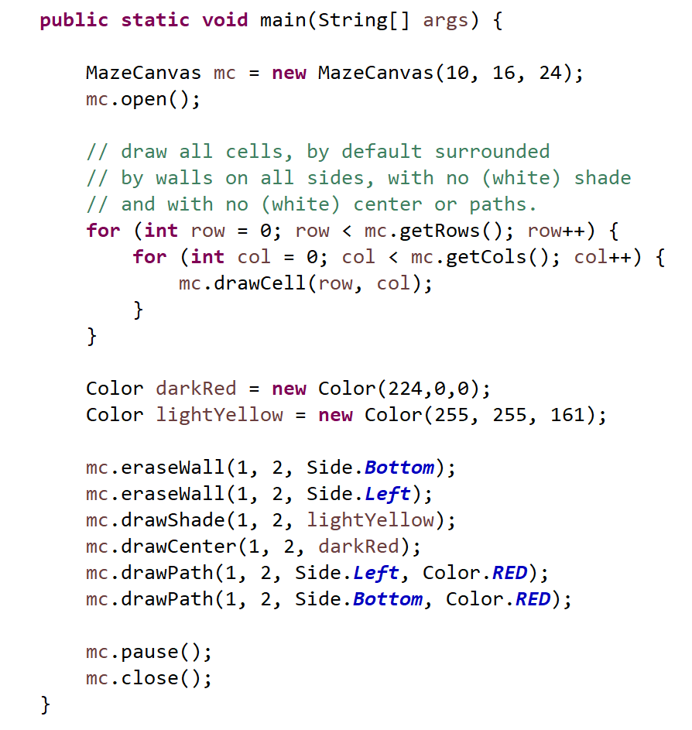
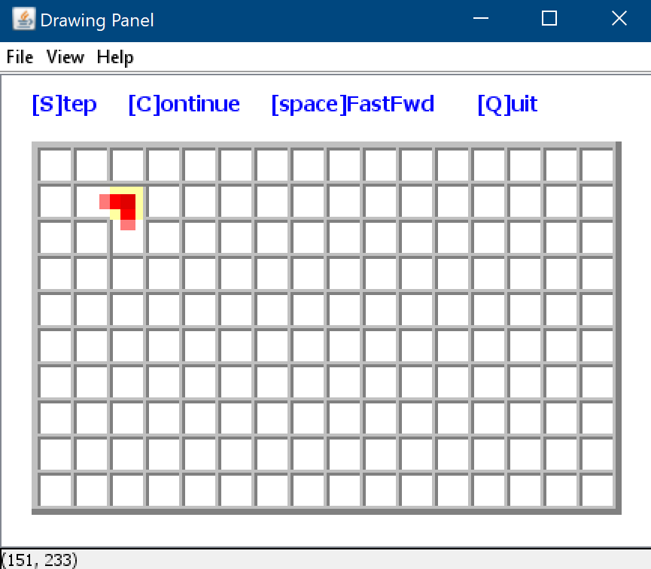
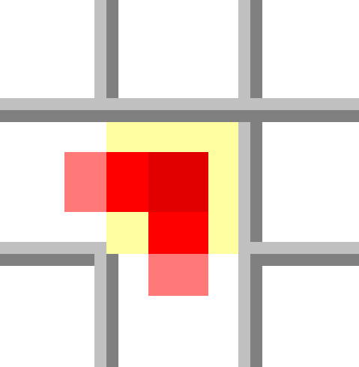


the Maze project
the MazeCanvas GUI framework
The Graphical User Interface (GUI) for this project is supported by a set of classes already available in your startup project. The graphics.jar package contains the class MazeCanvas through which you can draw all the graphical elements making up the maze, as follows:
The Maze is represented as a two-dimensional grid of cells. Each Cell has four sides. On each side, the cell may or may not have a Wall. The cell’s area can have a specific shade (background) color. On the cell’s area you can render a path connecting any of the four sides of the cell to its center.
Using the MazeCanvas class you can draw or erase any of the four walls of a cell or set the cell’s shade to a color of your choice. You can also draw or erase a path through the cell by connecting its center to any of the four edges.
The graphical elements of a maze cell are reflected below:
The Java code used for rendering the maze cell at row 1, column 2 in the example on the left is as follows:
10 rows
16 columns
Cell size in pixels
Erases the bottom wall of
the cell at row 1 and column 2.
Cell at row 1, col 2
Shade
lightYellow
Wall
Side.Top
Center
darkRed
The side of the wall being erased.
The color of the cell’s shade.
Path
Side.Left
Wall
Side.Right
The side and the color of the path being drawn.
Path
Side.Bottom
Ref: MazeCanvas API set:

Slide 19
the Maze project
the MazeCanvas API set
class MazeCanvas
MazeCanvas()
 | Creates a canvas fit for a maze of 16 x 24 cells, each sized to 20 x 20 pixels. The canvas is not displayed, to render it, use the method open().
MazeCanvas(int nRows, int nCols, int cellWidth)
 | Creates a canvas fit for a maze of nRows x nCols cells, each of cellWidth x cellWidth pixels. The canvas is displayed only when method open() is called.
int getRows() int getCols()
 | Returns the number of rows and columns configured for the maze canvas.
boolean open()
 | Renders a window GUI sized properly for hosting the maze canvas. Returns true on success or false if window is already open.
boolean clear()
 | Clears the content of the windows GUI while leaving the window open. Returns true if successful, false if the window is not opened.
boolean close()
 | Closes the window GUI. Returns true if successful, false if window is not opened.
boolean drawCell(int row, int col)
 | Draws a default cell at the row and col location. Cell is surrounded by walls on all sides, has a white shade and no path or center.
boolean drawCell(int row, int col, Color color)
 | Draws a cell at the row and col location. Cell is surrounded by walls on all sides, has the color shade and no path or center.
class MazeCanvas
boolean drawWall(int row, int col, Side side)
 | Draws a wall on the given side of the cell at the row and col location.
boolean eraseWall(int row, int col, Side side)
 | Erases the wall on the given side of the cell at the row and col location.
boolean drawPath(int row, int col, Side side, Color color)
 | Draws on the cell at the row and col location a path segment on the given side and color.
boolean erasePath(int row, int col, Side side)
 | Erases the path segment from the given side of the cell at the row and col location.
boolean drawCenter(int row, int col, Color color)
 | Draws the center of the cell at the row and col location in the given color.
boolean eraseCenter(int row, int col)
 | Erases the center of the cell at the row and col location.
boolean drawShade(int row, int col, Color color)
 | Draws the shade of the cell at row and col location in the given color.
boolean eraseShade(int row, int col)
 | Resets the shade of the call at row and col location to its default white color.
class MazeCanvas
boolean drawCaption(String caption)
 | Draws the given caption string under the maze area.
boolean drawCaption()
 | Erases any caption string from the canvas window.
boolean step()
 | If program is in “step-by-step” mode (default) it causes the program execution to stop until a key is pressed.
boolean step(long miliseconds)
 | Same as step(), unless the execution is in “continue” mode. In that case, execution will be paused for milliseconds duration.
boolean pause()
 | If the program is in “step-by-step”, “continue” or “fast-forward” mode it causes the program execution to stop until a key is pressed.
enum Side
{Left, Right, Top, Bottom, Center}
 | Values used to identify a side of a maze cell. Used for drawing or erasing walls and paths of a cell.

